Slide 1
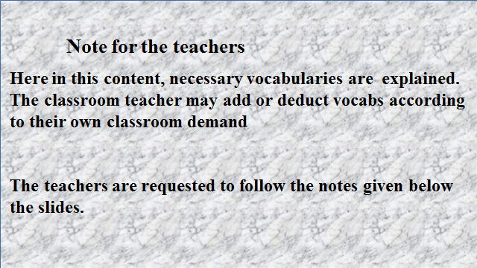

Slide 2
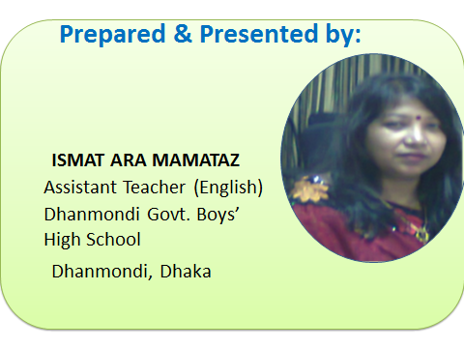

Slide 3


Slide 4
What do you see in the video?
Notes:
Showing the video, the teacher can ask 4/5 learners to say something on the video. Then he/she can go for declaring the topic.

Slide 5
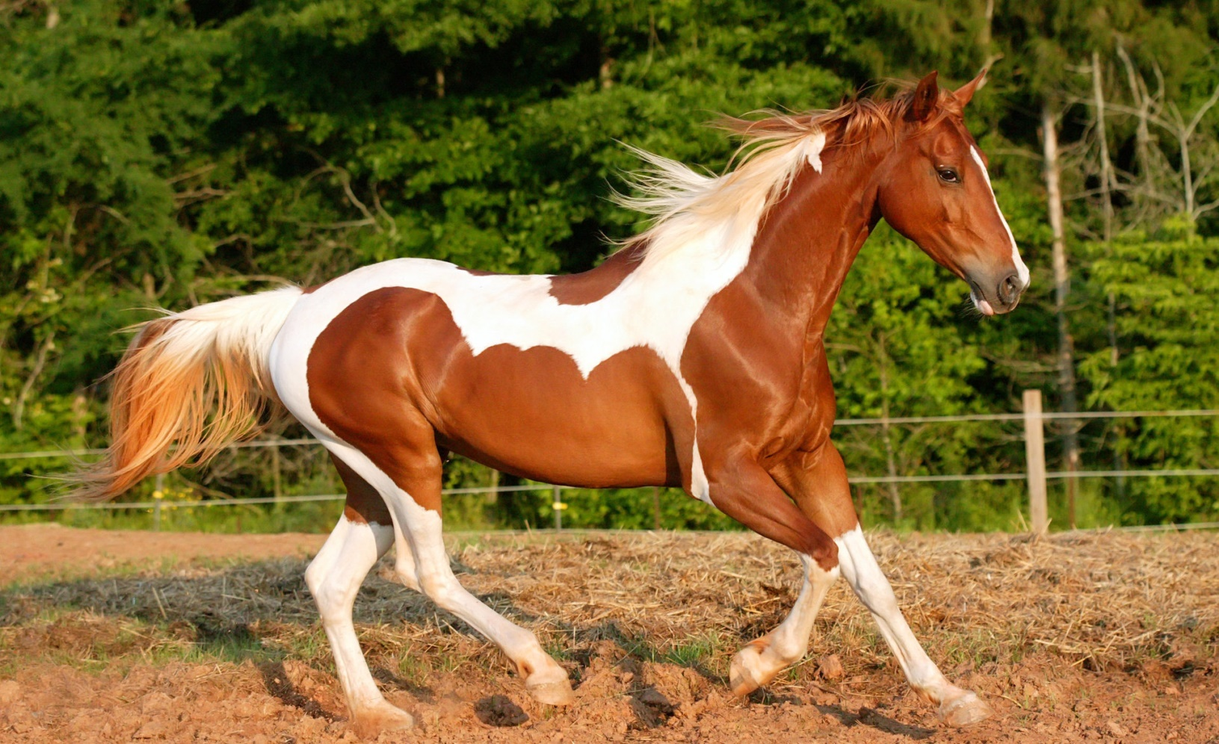

TODAY’S TOPIC
The horse can run fast.
Unit-5, lesson-2
Notes:
To make the learners clear about the topic, this picture is used here.

Slide 6
Learning Outcomes
By the end of the lesson, the learners will be able to…
identify auxiliary verbs.
explain the kinds of auxiliary verbs.
make meaningful sentences.
re-write a paragraph.

Slide 7
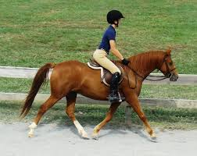
He is riding a horse.
Can you ride it?
Do you ride a horse?
Notes:
The learners will be asked to make more sentences following the given sentences.

Slide 8
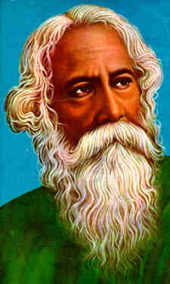
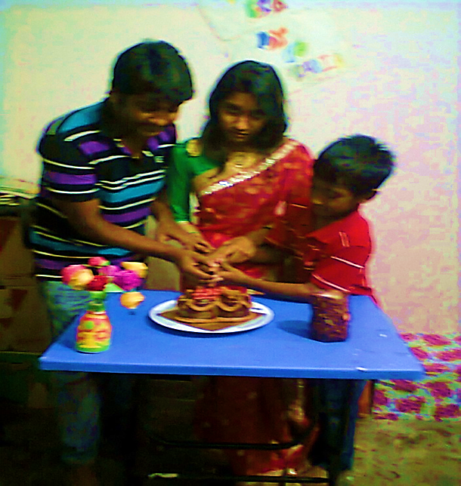
Spriha is cutting a cake.
Do you know him?
Auxiliary Verb
He did n’t lead a luxurious life.
Auxiliary Verb
Auxiliary verb
*AN auxiliary verb always takes place before a main verb.
Notes:
Showing the picture , the teacher may elicit the name of the person. Then he/she may go for explaining auxiliary verbs. After that, he/she may ask the learners to identify auxiliary verbs from their own made sentences.

Slide 9



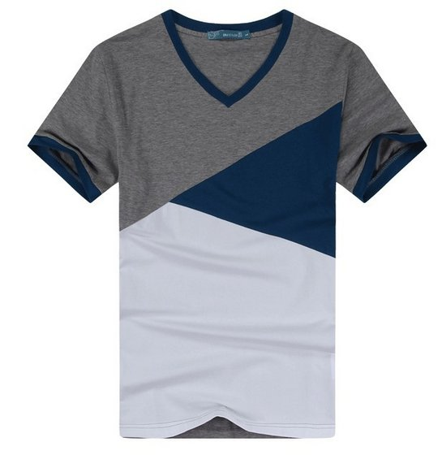
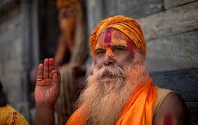
can
They can ride a bike.
should
may
Everybody should speak the truth.
May Allah help us.
may
May you be happy.
have
I have bought a new t-shirt.
Notes:
Learners will be asked make sentences with these verbs.

Slide 10
Fill in the blanks using auxiliary verbs:
1.I …… not believe in ghost.
2……. you tell me the way of the hospital?
3.We ……. respect our teachers.
4……. you ever been to Sunder bans?
5…….. you please help me?
6…..I go there?
7.You…help me.

Slide 11
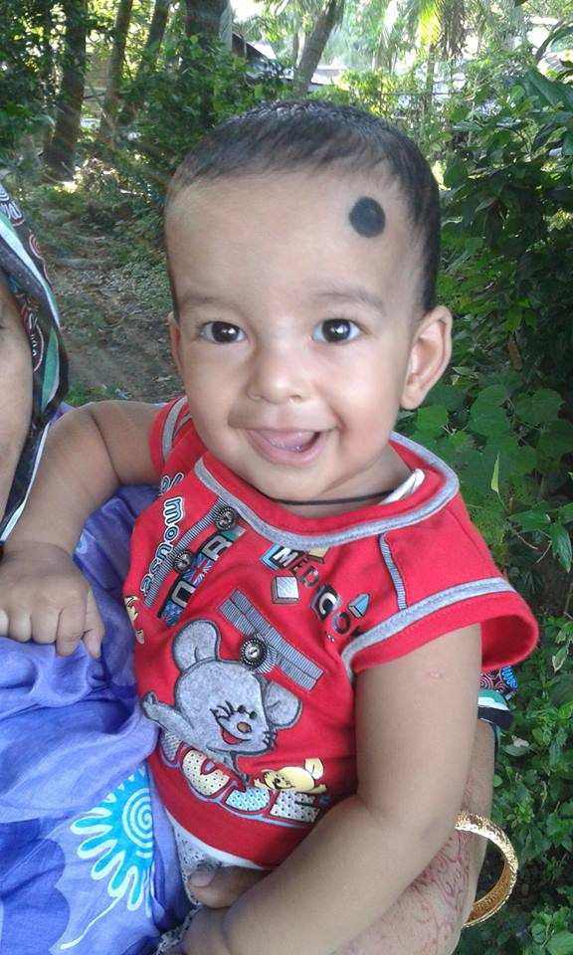
More activity
The baby ……. Laughing sweetly .It ….look gloomy. It….looking happy..…. You know it? How…. the baby laugh ? Who… holding it?

Slide 12
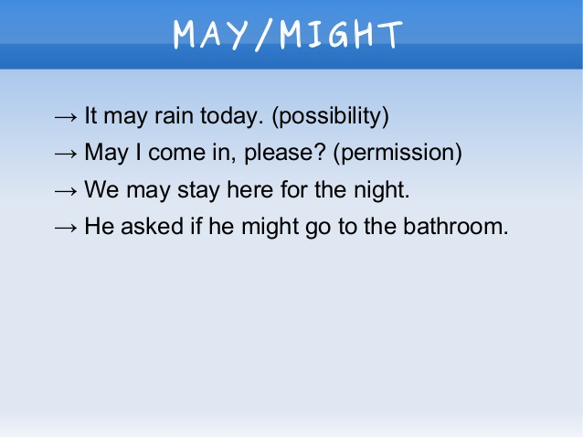
Use of may/might

Slide 13
At a Glance Types of Auxiliary Verbs
Auxiliary verbs
Verbs
Modal Auxiliaries-can,could,may,might,shall,should,will,would etc
Normal Auxiliaries-am,is,are,was,were,do,did,does,have,has,hades,

Slide 14
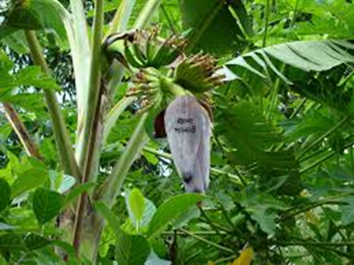

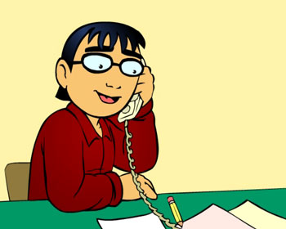

Pair Work
Discuss the pictures in pairs. and make at least four sentences using the four pictures.

Slide 15
Home work
Make 10 sentences using auxiliary verbs.

Slide 16

Thank You so much

Slide 17
Acknowledgement
MoE, DSHE, NCTB & A2I respective officials
And the editors panel:
Mr. Ranjit Poddar, Associate Prof, TTC, Dhaka,
Mr. Md. Jahangir Hasan, Asst. Prof, TTC, Rangpur,
Urmila Khaled Asst. Prof, TTC, Dhaka.
Their direction, valuable suggestions and intensive supervision have enriched the model contents.

